Slide 1
UPRRP 2018 How to Fund Your Graduate Education START NOW!
Presented by
Patti Ordóñez, PhD
NSF GRFP Recipient
Graduate Research Fellowship Operations Center
Notes:
Patti
Hello and welcome. On behalf of the Graduate Research Fellowship Operations Center, we would like to present to you the National Science Foundation’s Graduate Research Fellowship Program, or the NSF GRFP for short. We’d like to inform you about the award details and some things to keep in mind as you construct a competitive application.

Slide 2
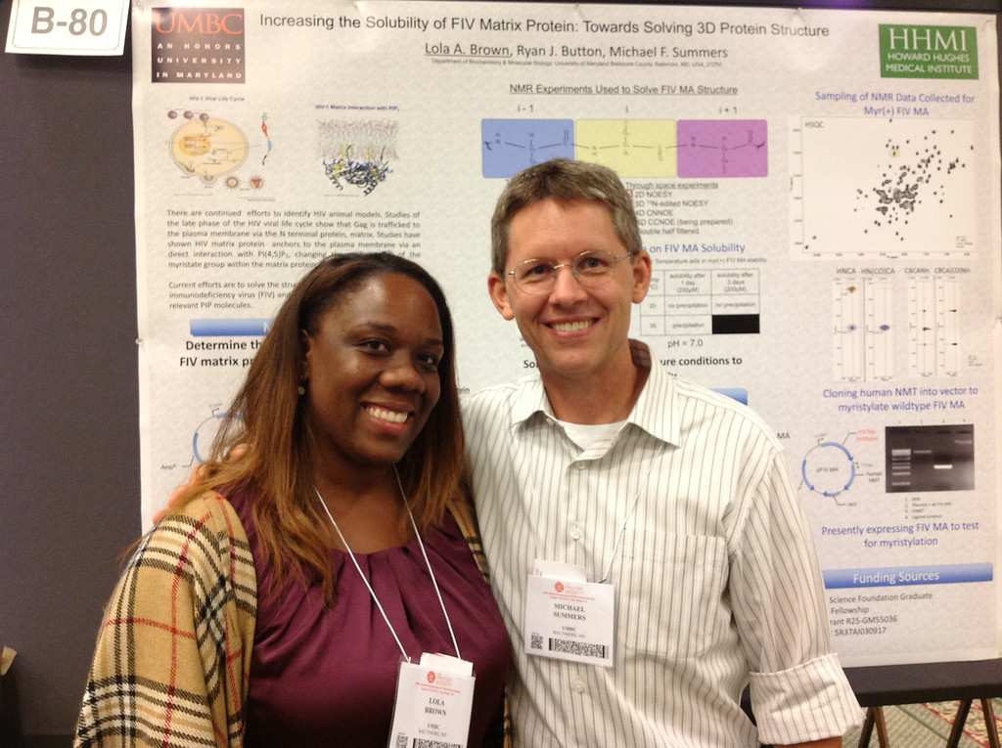
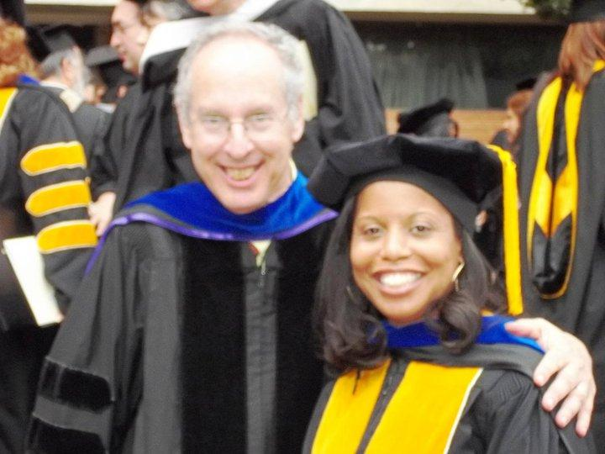
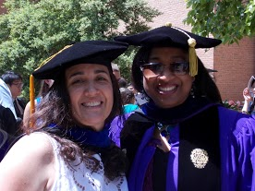
Desperation brings inspiration!!!
Notes:
Frances

Slide 3
Seminar Outcomes
Inform you of graduate funding opportunities
Introduce several domestic and international fellowships
Guide preparation of winning applications
Discuss Personal Statement and Proposal
Brainstorm on Personal Statements
LUNCH
Begin to write Personal Statements
http://ccom.uprrp.edu/~pordonez/NSFworkshop
Notes:
Patti

Slide 4
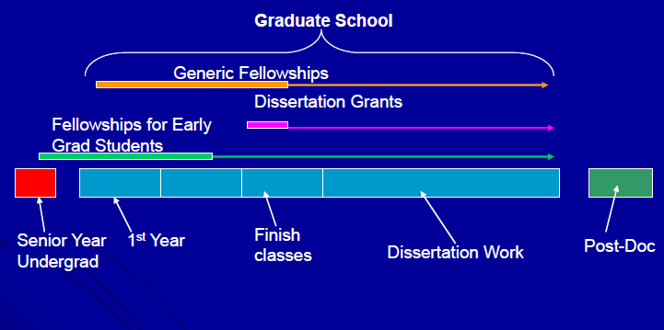
When can I get the money?
Continuum
Notes:
Frances
Resource from Megan Palsa of Texas A & M University

Slide 5
Where is the money?
Assistantships vs. Fellowships
Types of Fellowships
University - BD, GAANN/Jacob Javits, Meyerhoff
State & Regional – SREB, local congressmen
Private - Hertz, Ford, Hughes, Woodrow Wilson, Jack Kent Cooke
Industry - Honda, IBM, GEM…
Agency - NASA, EPA, DHS, DoEd, DoEnergy, DOD, Air Force
National/International - NSF GRFP/Fulbright
Notes:
Frances
GAAAN and Jacob Javits combined in FY 2012 for awards in 2013 and 2014.

Slide 6
The Good, the Bad and the Ugly
 | University Fellowship | Advisor Support | External Funding
Choose the advisor YOU want | May vary | Difficult to change advisors | Easier to change advisors
Advisor runs out of money | Department may support student, may need to switch advisors, sometimes dismissal | You or advisor need to come up with new source of funding | You will still be paid!
Partial funding | First year only | At advisor’s discretion | Many fellowships for 3+ years
Teaching requirement | Usually | At advisor’s discretion (may ask you to teach to supplement their financial support) | NO
Makes you more competitive for (academic) jobs | No | No | YES

Slide 7
Show me the money…
http://www.ncsu.edu/grad/financial-support/fellowships.html (fellowships by deadline date)
http://gradschool.umbc.edu/funding/fellowships/
http://www.finaid.com/ and http://www.fastweb.com/
https://bigfuture.collegeboard.org/scholarship-search
http://sites.nationalacademies.org/pga/Fellowships/PGA_046301
http://hsf.net/en/scholarships/programs/
https://scholarships.uncf.org/
http://www.scholarshipexperts.com/
http://fulbrightonline.org/ (International)
http://ww2.kdp.org/images/PC_Resources/Finding_Funding_for_Grad_School.pdf
Notes:
Frances
Robin Walker at Missouri
For computer science
http://research.microsoft.com/apps/mobile/showpage.aspx?page=/en-us/collaboration/awards/fellows-women.aspx
http://www.google.com/anitaborg/
http://scholarships.hispanicfund.org/applications/subsectionID.1,pageID.123/default.asp
http://googleblog.blogspot.com/2007/01/uncfgoogle-scholarship.html

Slide 8
International style money
Websites to help you find the money
http://www.ncsu.edu/grad/financial-support/fellowships.html (fellowships by deadline date)
http://www.hhmi.org/programs/international-student-research-fellowships
http://www.conacyt.gob.mx/index.php/becas-y-posgrados
http://www.scholarshipportal.com/
http://www.echoinggreen.org/fellowship/echoing-green-fellowship
http://sites.nationalacademies.org/pga/Fellowships/PGA_046301
http://www.scholarshipexperts.com/
http://www.intlstudent.org/scholarships.html
http://foreign.fulbrightonline.org/
http://www.foreignborn.com/study_in_us/8-paying4school.html
Notes:
Frances
NCSU – Soros Fellowship and NRC Research Associate Programs with opportunities for foreign nationals; MUST Review each to see if eligible
HHMI – Support outstanding mid-career international students (2nd or 3rd year graduate students)
GEM – permanent residents
Marie Curie – for studying in Europe
Echoing Green – Business Innovation Fellowship to
Conacyt – Organization to support scientific innovation in Mexico. Offers scholarships to study domestically and abroad for Mexican citizens/professionals
ISO – International Student Org in the USA – list of scholarships for international students

Slide 9
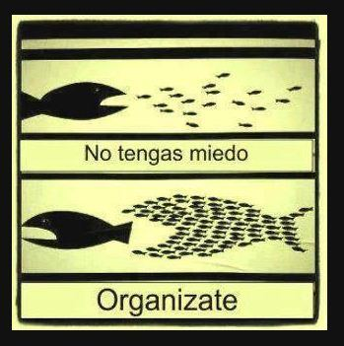
Organize Yourself
Don’t be scared
Get organized
Notes:
Patti

Slide 10
Separate by Folders
GRE Scores
CV
Transcript
Notes:
Patti

Slide 11
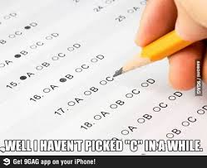
GRE Scores
CV
Transcript
Notes:
Patti

Slide 12
Keep Track
-Universities
-Links
-Usernames
-Passwords
-Essay questions
-Transcript submission
instructions
-Application submission
instruction
-Color coordinated (helps!)
Notes:
Patti

Slide 13
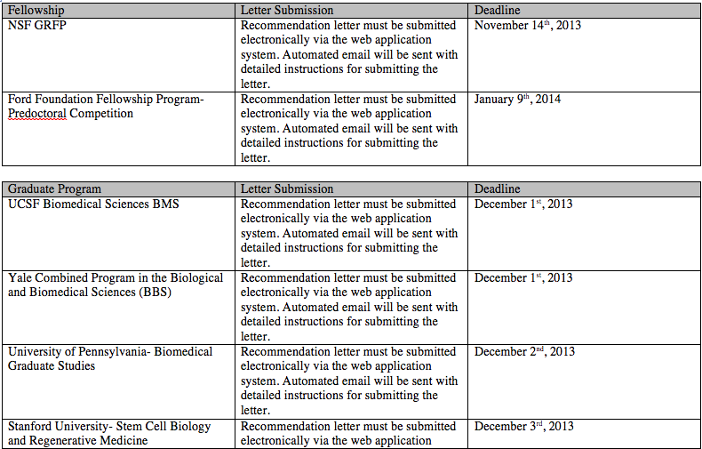
Sample Charts
Notes:
Patti

Slide 14
Sample Charts
Notes:
Patti

Slide 15
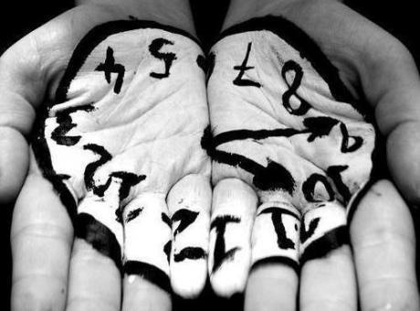
Many Drafts!!
Many Mentors!!
Notes:
Frances

Slide 16
Many Mentors
Identify mentors that are eager to be exposed to your ideas and willing to guide you during the process.
Choose those mentors that encourage strategic thinking and creativity while imparting a set of skills.
Mentors in and outside of your field of study.
Notes:
Frances

Slide 17
The NSF Graduate Research Fellowship Program
National Science Foundation
Graduate Research Fellowship Program Operations Center
Notes:
Frances –
Alternately, can show 60th anniversary video about the program…. http://www.nsf.gov/news/news_videos.jsp?cntn_id=126221&media_id=73501&org=NSF

Slide 18
Complete Application
NSF FastLane
Personal, Relevant Background and Future Goals Statement (3 pages)
Graduate Research Statement (2 pages)
Transcripts, uploaded into FastLane
Three letters of reference required
Additional information required for some candidates See Solicitation for eligibility requirements (available on www.nsfgrfp.org)
Notes:
Frances

Slide 19
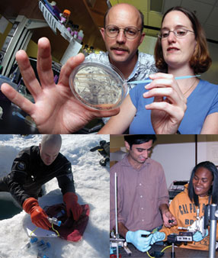
GRFP General Eligibility
U.S. citizens, nationals, and
permanent residents
Early-career students
Pursuing research-based
MS or PhD in NSF fields
Enrolled in accredited U.S.
institution by fall 2019
Applicants must self-certify in the application that they meet the GRFP Eligibility criteria
Notes:
Patti

Slide 20
GRFP General Eligibility
U.S. citizens, nationals and permanent residents that will be enrolled in an accredited STEM research-based graduate program in the Fall.
Academic levels:
Seniors with no graduate study yet
Graduate students can apply 1 TIME ONLY in graduate school either as:
First-year graduate students OR
Second-year graduate students (≤ 12 months of graduate study by August)
Greater than 12 months of graduate study, with interruption in graduate study of 2 or more years (can have MS degree)
Notes:
Patti

Slide 21
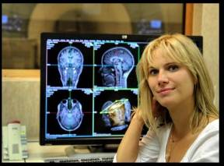
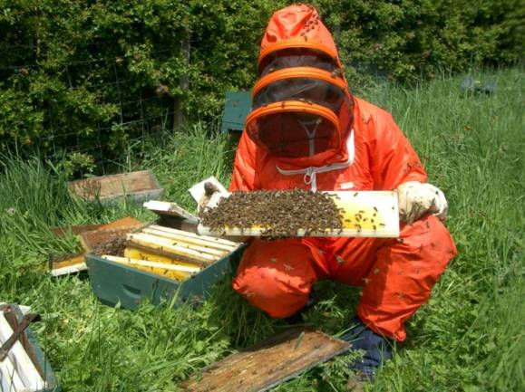
GRFP Cycle
Application: Available online August
Deadlines: Late October, early November (varies by field)
Awards: Announced late March to early April
Best Time to Start Preparing: Now
Notes:
Patti

Slide 22
2019 GRFP Deadlines
2019 Deadlines:
October 22, 2018 (Monday) Life Sciences, Geosciences
October 23, 2018 (Tuesday) Computer and Info Science and Engineering, Engineering, Materials Research
October 25, 2018 (Thursday) Psychology, Social Sciences, STEM Education and Learning
October 26, 2018 (Friday) Chemistry, Mathematical Sciences, Physics and Astronomy
November 1, 2018 (Thursday) Reference Letter Deadline
All documents are due by 5pm EST
Notes:
Patti

Slide 23
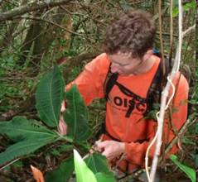
NSF Graduate Research Fellowship Program Goals
To increase the Nation’s human capacity in science and engineering by providing fellowships for early-career graduate students who pursue research-based master’s and doctoral degrees in NSF-supported disciplines
To support the development of a diverse and globally engaged US science and engineering workforce
Notes:
Frances

Slide 24
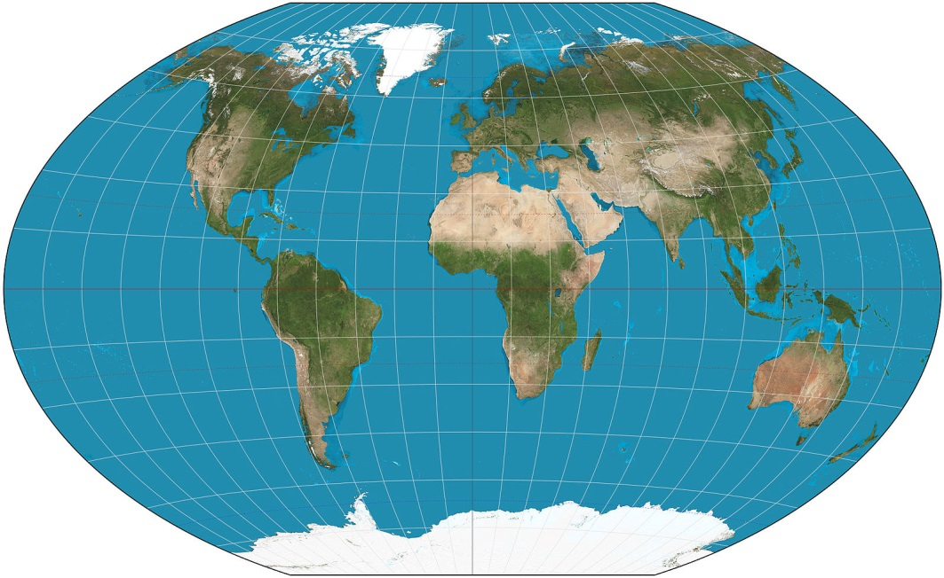
GRFP Key Elements
Five Year Award – $138,000
Three years of financial support
$34,000 Stipend per year
$12,000 Educational allowance to institution per year
International research
through GROW
Internships through GRIP
Access to XSEDE
cyberinfrastructure resources
Perform research through the GRFP in countries such as Chile, Denmark, Finland, France, Ireland, Japan, the Netherlands, Norway, Singapore, South Korea, Sweden and Switzerland!
Notes:
Patti
Find out list of countries for GROW = Graduate Research Opportunities Worldwide
Co-Author of Freakanomics – Steven Levitt
Find out number of universities on the XSEDE grid = acceso a rede de supercomputadoras avanzadas en 19 universidades e instutitos en la nación americana
Flexible: choice of project, advisor & program
Unrestrictive: No service requirement
Portable: Any accredited U.S. institution
MS PhD
2,000 Fellowships offered annually, 2010 - 2013
~17% success rate

Slide 25
GRFP Unique Features
Flexible: choice of project, advisor & program
Unrestrictive: No service requirement
Portable: Any accredited U.S. institution
MS PhD
2,000 Fellowships offered annually our of 14,000, 2010 - 2013
~17% success rate
Notes:
Frances

Slide 26
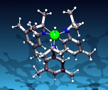
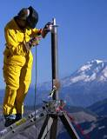
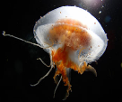
GRFP Supported Disciplines
Chemistry
Computer and Information Science and Engineering
Engineering
Geosciences
Life Sciences
Materials Research
Mathematical Sciences
Physics and Astronomy
Psychology
Social Sciences
Science, Technology, Engineering and Mathematics Education (research-focused)
Notes:
Patti

Slide 27
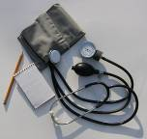
Not Supported by NSF GRFP
Business administration or management
Social work
Medical, dental, law, or public health programs
Joint science-professional degree programs, e.g., MD/PhD, JD/PhD, etc.
Education (except research-focused STEM Education programs)
See Solicitation (www.nsfgrfp.org)
Notes:
Patti

Slide 28
Review Criteria
Two National Science Board-approved Review Criteria:
Intellectual Merit: this criterion encompasses the potential to advance knowledge
Broader Impacts: this criterion encompasses the potential to benefit society and contribute to the achievement of specific, desired societal outcomes
Notes:
Patti

Slide 29
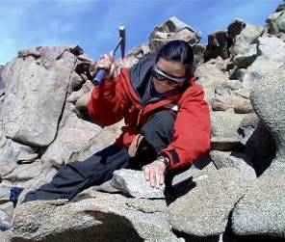
Intellectual Merit and Broader Impacts Assessment
Personal, Relevant Background and Future Goals Statement
Graduate Research Statement
Reference Letters
Transcripts
Notes:
Patti

Slide 30
The following elements should be considered in the review for both criteria:
What is the potential for the proposed activity to
Advance knowledge and understanding within its own field or across different fields (Intellectual Merit); and
Benefit society or advance desired societal outcomes (Broader Impacts)?
To what extent do the proposed activities suggest and explore creative, original, or potentially transformative concepts?
Is the plan for carrying out the proposed activities well-reasoned, well-organized, and based on a sound rationale? Does the plan incorporate a mechanism to assess success?
How well qualified is the individual, team, or organization to conduct the proposed activities?
Are there adequate resources available to the PI (either at the home organization or through collaborations) to carry out the proposed activities?
Notes:
Patti

Slide 31
Intellectual Merit
Panelists may consider the following with respect to the Intellectual Merit Criterion:
the potential of the applicant to advance knowledge based on the totality of the content in the application, including the strength of the academic record, the proposed plan of research, the description of previous research experience or publication/presentations, and references
Notes:
Patti

Slide 32
Broader Impacts
Panelists may consider the following with respect to the Broader Impacts Criterion:
the potential for future broader impacts as indicated by personal, professional, and educational experiences
Notes:
Frances

Slide 33
Preparing a Competitive Application
Choose at least three reference writers
Give them ample time
Must know you as a scientist and personally
Share your application materials and the merit review criteria (Intellectual Merit and Broader Impacts) http://nsfgrfp.org/reference_writers/requirements/
Track letter submission using FastLane
Must have 2 letters but no more than 3
http://renettatull.wordpress.com/2011/03/03/youve-just-asked-for-a-letter-of-recommendation-now-i-need-some-things-from-you/
Notes:
Patti

Slide 34
Preparing a Competitive Application
Read the Solicitation carefully – Are you eligible? What are requirements?
Address the Review Criteria (two NSF Merit Review Criteria -Intellectual Merit and Broader Impacts throughout)
Check for spelling and grammatical errors
Verify statements and transcripts uploads
For NSF, you must self-certify your eligibility according to the criteria in the Solicitation and that is your original work
Make sure you Press “Submit” button
Regularly check application status for # of reference letters
Make sure you are enrolled in graduate school by Fall 2019
Notes:
Patti

Slide 35
Evaluation of applications
Panelists are academic and research experts in general discipline, not necessarily in your research topic
Panelists rate your application using the two Merit Review Criteria, Intellectual Merit and Broader Impacts
NSF requests panelists to provide constructive comments (applicants receive anonymous copies of the reviews)
Panels make recommendations to NSF
NSF awards fellowships and honorable mentions
Notes:
Patti

Slide 36
Insight From An Experienced Panelist
Common Reasons Applicants Not Successful:
Poor Broader Impacts
Choice of prestigious school over research-matched school
Inappropriate or uninformative references
Weak personal statement
Notes:
Patti
Aquí les ponemos algunas razones por las que panelistas de la beca rechazan una solicitud:
Broader Impacts pobres.
- Muchos estudiantes no hablan bien sobre sus broader impacts o dicen muy poco sobre ellos.
Estudiantes que prefieren escoger universidades prestigiosas versus universidades que tengan los recursos para el tema de investigación.
Estudiantes que escogen cartas de recomendaciones de profesores inapropiadas que no pueden hablar mucho sobre sus habilidades personales y de investigación. Esto pasa cuando los estudiantes escogen como referencia al profesor con el que harán su investigación a nivel graduado y este profesor todavía no sabe mucho sobre los estudiantes.
Ensayo personal débil y poco convincente que no habla bien sobre sus virtudes.
Maria - pull out the Tips for Applying PDF
Here are some reasons an experienced panelist cited they commonly see as “deal breakers” for applicants. Many do not address broader impacts very well and say very little on that entire area. Some believe that choosing a well-known institution for proposed study will score them points with the reviewers, when often it is not a good match for their research. Some will choose references that cannot speak much to their research or personal abilities, and so these letters of support come across weak. If applicants asked their proposed mentor to write a letter, sometimes their support is not very strong. Oftentimes, applicants will put together an unconvincing personal statement that does not fully portray their strengths. Really try to keep these points in mind when you are putting together the application, and your chances of winning an award will be greater.

Slide 37
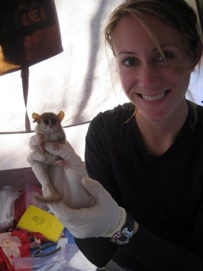
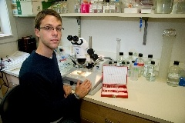
Resources at nsfgrfp.org
Tips for applying
Frequently asked questions (FAQ)
Find GRFP contacts
Important links for the GRFP
Panelist registration
Notes:
Frances

Slide 38
Resources at Your University
Facebook
@cdcluprrp
Notes:
Frances

Slide 39
More NSF Resources
NSF GRFP Website (nsf.gov/grfp)
Solicitation
FAQ and Guide links
Fastlane.nsf.gov/grfp
Online application, user guides, official announcements
Phone and email
866-NSF-GRFP (673-4737)
info@nsfgradfellows.org
And …
- Research Mentors
Former panelists
Program coordinators
Professors
NSF GRFP recipients
Family
Friends
Notes:
Frances

Slide 40
More External Resources
NSF GRFP Winning Essays
http://tinyurl.com/NSFGRFPExamples
Insights on Fellowship
http://grfpessayinsights.missouri.edu/
Self-Scoring Rubric for Essays
https://www.research.msstate.edu/rresources/pdf/NSF_fellowship_rubric.pdf

Slide 41
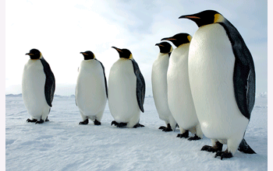
Win by Believing in Yourself, Your Community, and Your Talents
Avoid Self-Disqualification
All other applicants are “more qualified”
Research, activities, or contributions are not impressive enough
Not enough experience
Not able to express things well
NSF funds studies of emperor penguins who are rife with belief in themselves
Notes:
Frances/Patti
A big issue a lot of applicants run into is they believe they can’t possibly be good enough to win an award that has a 10% success rate. You might invent a lot of things in your mind to tell yourself that you can’t possibly be qualified enough, that what you’ve done is not that great, your experience is not enough, and you just can’t say things the way you want them to come out. A lot of people think like this collectively, and these are all things that are usually untrue. Think of this application process as a community project. Talk to those people around you for advice and thoughts about what you might talk about. It is important to be confident about your abilities because that will come across in your application. If you have seen “March of the Penguins”, you know that they have to have a ton of belief in themselves and their community to produce just one baby in super harsh conditions. Humans have things much better, so by comparison this should be a piece of cake.

Slide 42
Apply to Win
Applying always produces a winning result!
Besides feedback on your ideas from experts, it is great preparation for:
Other award applications
Graduate school applications
Job applications
Writing publications
Professional connections
…and you just might win the fellowship too!
2,000 Awards
14,000 Applications reviewed
~ 17% Success
Notes:
Frances/Patti
If you go through this application process, you will always win. You are getting feedback from professionals in the field essentially for investing your time. To put things in perspective, this award is worth $122,500 in total benefits. Even if you spend 3 full time weeks on putting an application and get an award, you have worked for over $1,000 per hour. That is a nice hourly rate. The whole process is also great preparation for other awards you may want to apply, graduate school applications, job applications, publications, and professional connections. Of course if that’s not good enough, you might also win the fellowship. We wish you all the best and look forward to reviewing your application.

Slide 43
Reflection
What is graduate funding and Why is it important to try to fund your graduate education?
Notes:
Patti/ Frances

Slide 44
http://ccom.uprrp.edu/~pordonez/NSFworkshop
Notes:
Break

Slide 45
Complete Application
NSF FastLane
Personal, Relevant Background and Future Goals Statement (3 pages)
Graduate Research Statement (2 pages)
Transcripts, uploaded into FastLane
Three letters of reference required
Additional information required for some candidates See Solicitation for eligibility requirements (available on www.nsfgrfp.org)
Notes:
Frances

Slide 46
Personal, Relevant Background and Future Goals Statement (3 pages)
How do you envision graduate school preparing you for a career that allows you to contribute to expanding scientific understanding as well as broadly benefit society? Describe your personal, educational and/or professional experiences that motivate your decision to pursue advanced study in science, technology, engineering or mathematics (STEM). Include specific examples of any research and/or professional activities in which you have participated. Present a concise description of the activities, highlight the results and discuss how these activities have prepared you to seek a graduate degree. Specify your role in the activity including the extent to which you worked independently and/or as part of a team. Describe the contributions of your activity to advancing knowledge in STEM fields as well as the potential for broader societal impacts (See Solicitation, Section VI, for more information about BI)
Notes:
Frances

Slide 47
Essay Critique
Before
After
Notes:
Patti

Slide 48
Tips to an Award-winning NSF GRFP Personal Statement
Make it personal, make it yours! You have a UNIQUE perspective!
Scientific, not flowery.
Show your passion. SHOW IT, DON’T TELL IT!
Describe your most important research experiences and connect them to your personal experiences. -> INTELLECTUAL MERIT
Specify throughout your essay:
WHY do you want to go to grad school?
WHAT are your future goals after grad school?
WHICH research topics interest you the most?
WHAT kinds of unique insights may you offer as a minority student?
HOW will the NSF GRFP help you achieve your goals?
HOW you will give back to the community? ->BROADER IMPACTS
Proofread, proofread, proofread.
Notes:
Frances
Robin Walker at University of Missouri

Slide 49
Graduate Research Plan (2 pages)
Present an original research topic that you would like to pursue in graduate school. Describe the research idea, your general approach, as well as any unique resources that may be needed for accomplishing the research goal (i.e., access to national facilities or collections, collaborations, overseas work, etc.) You may choose to include important literature citations. Address the potential of the research to advance knowledge and understanding within science as well as the potential for broader impacts on society. The research discussed must be in a field listed in the Solicitation (Section X, Fields of Study).
Notes:
Frances
Read and now the research field of your project, what info is missing? What don’t we know?
Brainstorming of many many projects you will like to propose
Talk to your mentors
Key points:
Novel approaches
In depth
Realistic plan

Slide 50
Guide to a successful research proposal
Read and know the research field of your project
Where is the field moving?
What is the next step of your research project from a summer program or at your home institution?
Brainstorming on the different project ideas
Discuss your research plans with your mentors
Key points:
Novel approaches
In depth
Realistic plan
Notes:
Patti
Realistic plan -> research matches the university you applied to

Slide 51
FORD FOUNDATION FELLOWSHIPS AND GRANTS

Slide 52
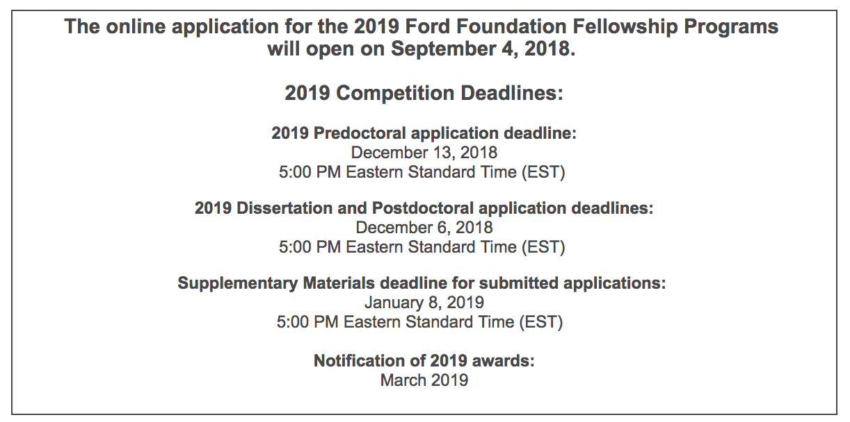
Ford Foundation Deadlines

Slide 53
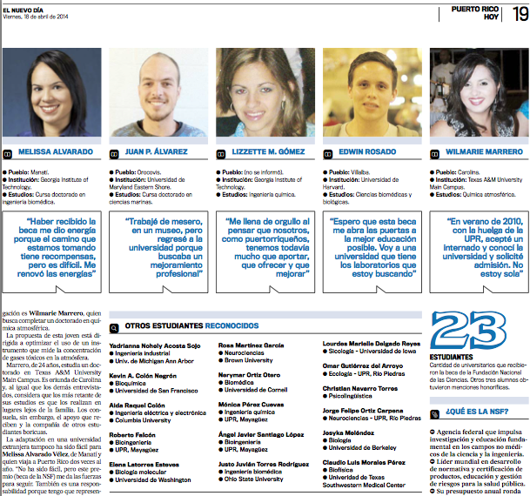
GRFP Recipients from PR

Slide 54
Reflection
With what you know now, how are you better prepared to fund your graduate education?
Notes:
Patti

Slide 55
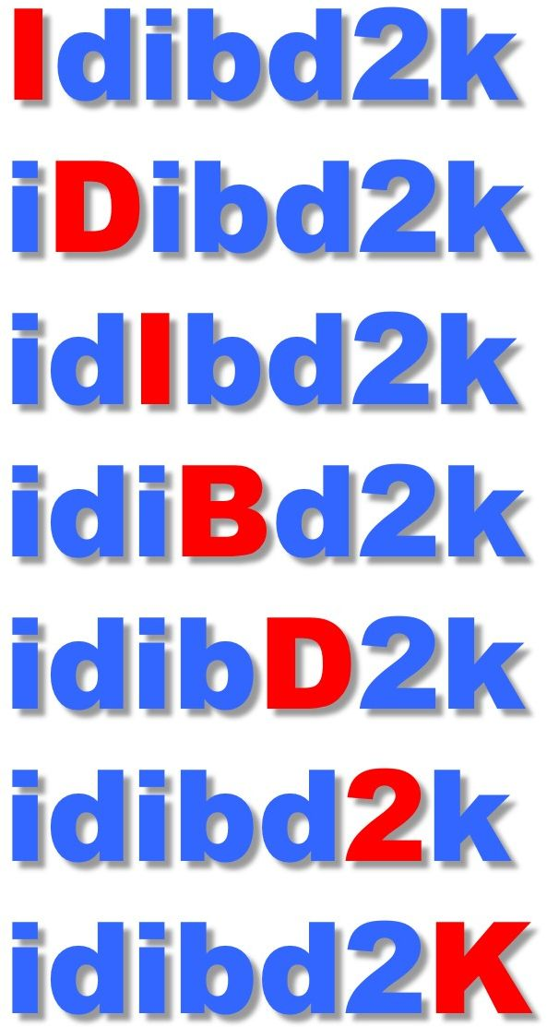
Thank you
Questions?? Feel free to contact us…
María Ocasio Torres, PhD
mariapr_24@yahoo.com
Patricia Ordóñez, PhD
pattiordonez@gmail.com
Diana Silva
dianavsilva@gmail.com
Thanks to Frances Carter-Johnson, CAHSI, Woodrow Winchester, Nicole Aponte, Jorge Ortiz-Carpena, Edwin Rosado for their contributions to this presentation.
This presentation and several other resources can be found at moodle.com.uprrp.edu in the open course –
“How to fund your graduate education”
Notes:
Patti

